Slide 1
License Plate Recognition using Raspberry Pi & Tesseract OCR Engine
Project Graphics
By:
Wei Kit Wong, Daemon Macklin,
Joseph Rodrigues, Yu Zhang

Slide 2
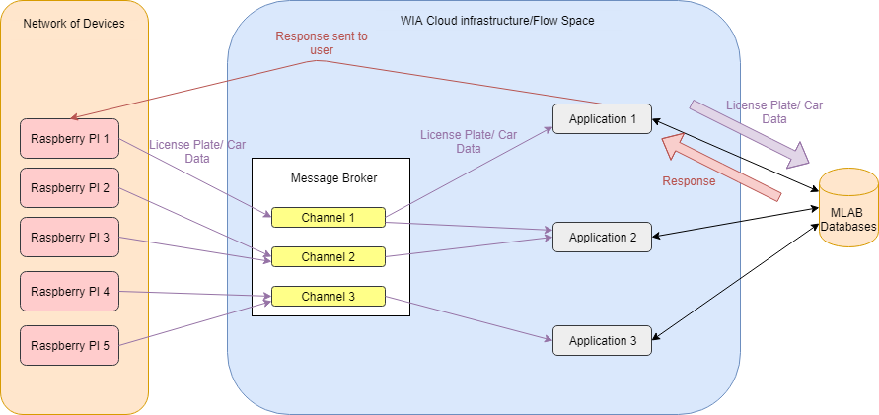
Block Diagram of Overall System

Slide 3
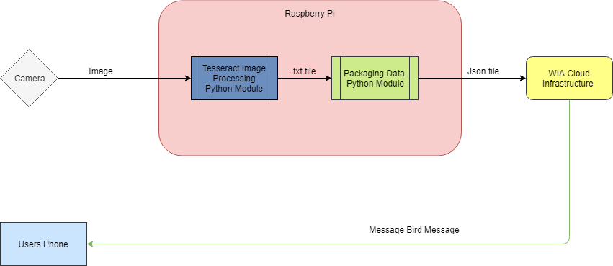
Flowchart of Local System

Slide 4
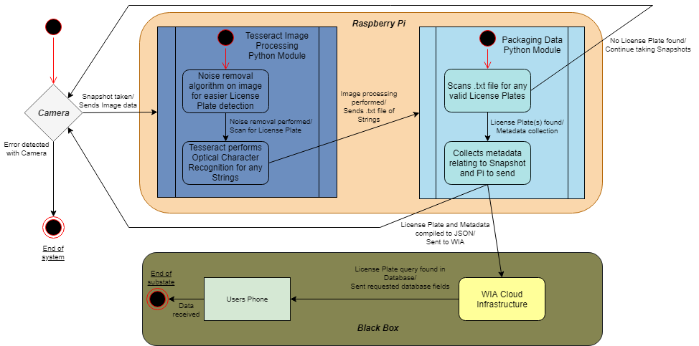
Statechart of Camera / Raspberry Pi Interaction
In-depth look of Image Processing and Packaging Data in Raspberry Pi.
Treats the different devices as different states (e.g. Camera, Raspberry Pi).
Note that the Pi loops back to the Camera the same time as it proceeds to the “Black Box”.

Slide 5
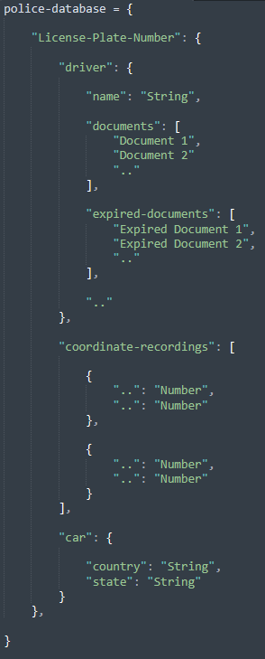
Document Object Model of Police System’s Database
This Police System is one example of an Application that subscribes to the Message Broker that can be implemented.
DOM shows what the structure of the database and what can be accessed and stored.
Note that this DOM follows the JSON notation.
Notes:
Original purpose of project was to use ALPR for Police, now used and implemented as an example as a subscriber to the Message Broker.
Database has driver name, documents, etc.
Optionally the most recent coordinates of the snapshots found can be recorded..

Slide 6
Any Questions?

